Slide 1
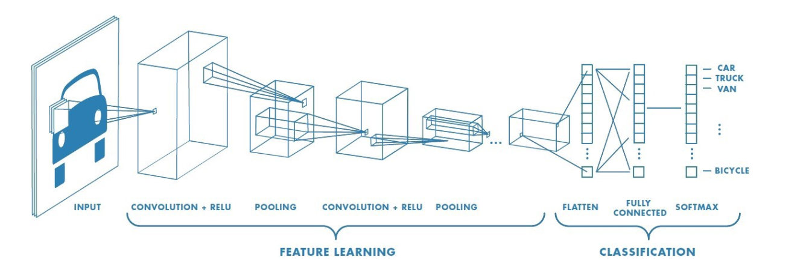
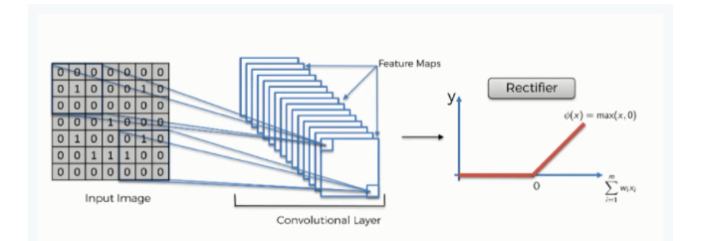
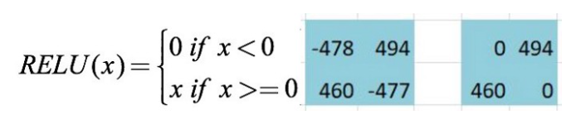
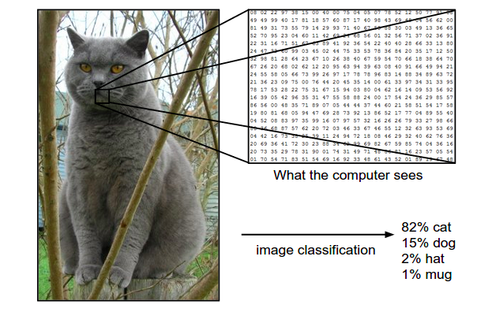
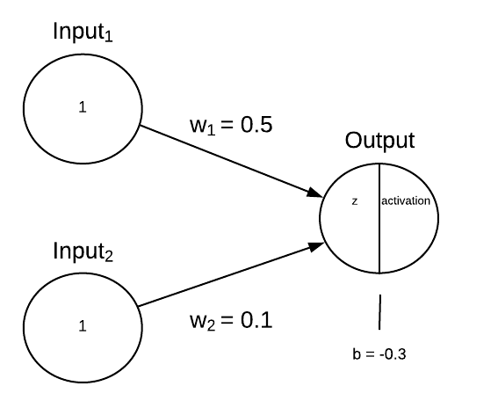

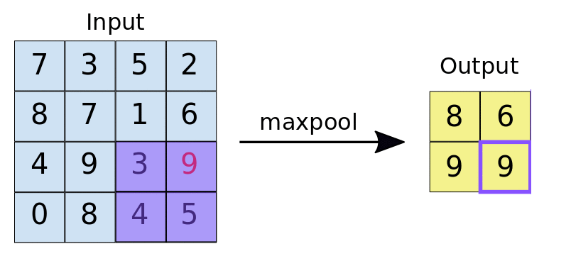


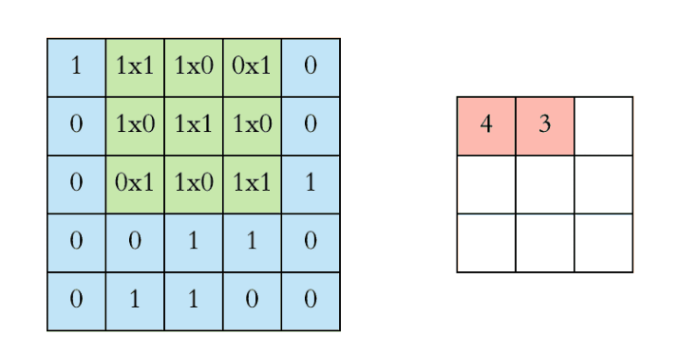
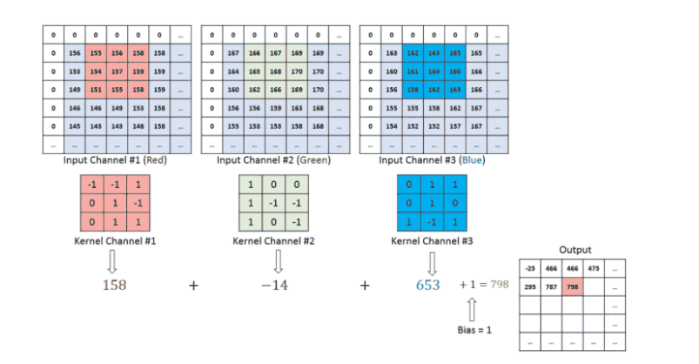
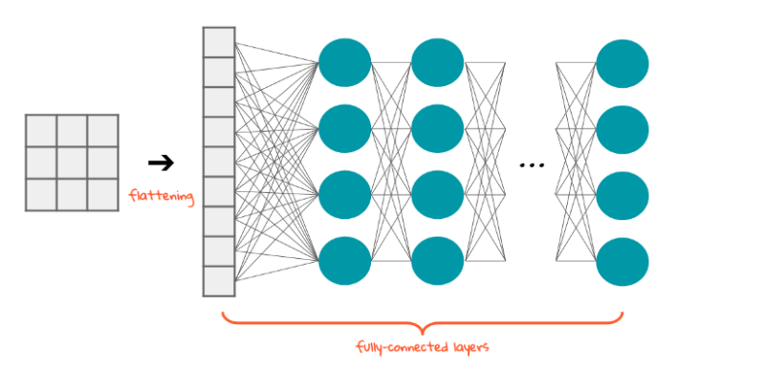
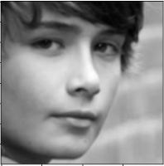
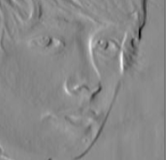
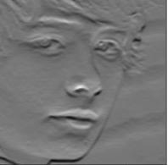
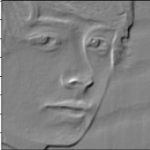
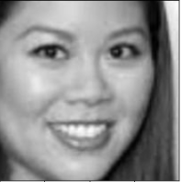
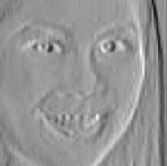
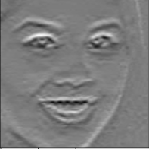
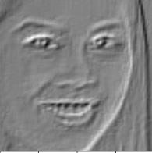
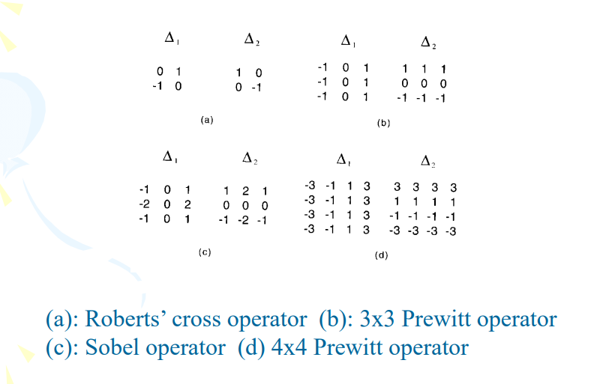
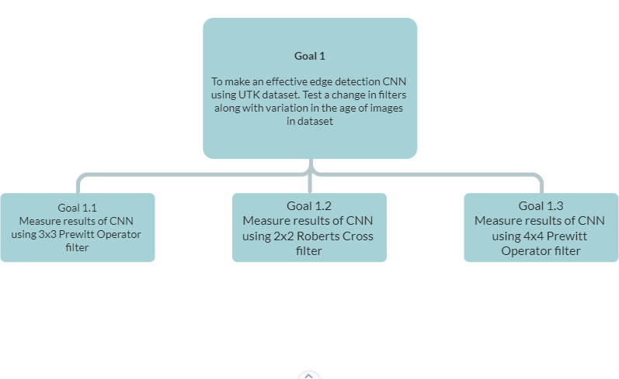
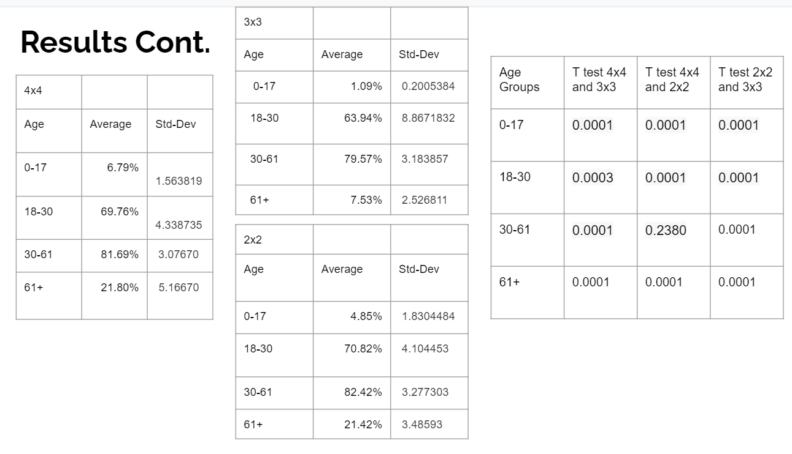
Filter Size Analysis for Facial Recognition with CNN’s
By John Robinson Mentored By Dr Girard
Problem Description
Fully Connected Layer
This point becomes a normal neural network with the flattened feature vector is in input for the neural network so must through process of forward and backward propagation. Numbers are randomly generated for bias and weight
Develop a image recognition neural network using a convolutional neural network.
ReLU activation
ReLU is the max function(x,0) with input x e.g. matrix from a convolved image. ReLU then sets all negative values in the matrix x to zero and all other values are kept constant.
What is a convolutional neural network?
Forward Propagation
Forward propagation (or forward pass) refers to the calculation and storage of intermediate variables (including outputs) for a neural network in order from the input layer to the output layer
Pooling
The function of pooling is to continuously reduce the dimensionality to reduce the number of parameters and computation in the network. This shortens the training time and controls overfitting
The objective of the Convolution Operation is to extract the high-level features such as edges, from the input image
Flattening Layer
Flattening is the process of converting the result of the convolutional layers into a one dimensional array so that it can connect to the fully connected layer.
Backward Propagation
Backpropagation refers to the method of calculating the gradient of neural network parameters. In short, the method traverses the network in reverse order, from the output to the input layer, according to the chain rule from calculus
The Experiment
Solution Description
Python using Jupyter Notebook were used to code and compile the convolutional neural network.
Created the Convolution layers and neural network layers from scratch, no packages apart from number generation and converting images to an array etc…
Tested CNN on UTK dataset. Dataset made up of faces from a range of ages, races and other distinguishing features.
Trained on 80% and tested on 20% of the data for each edge detection filter
Overall accuracy calculated based on number of correct guesses during testing
The facial recognition CNN will be developed and trained in a python environment with filter sizes of 2x2,3x3,4x4. The kernels for each being the roberts cross for the 2x2, Prewitt for the 3x3 and Prewitt operator for the 4x4, these are also referenced in the figure below. Comparing resulting accuracy to find best results. The secondary variables will include the use of zero padding, one convolution layer, sigmoid activation function for the classification, one hidden layer in classification, and the use of max pooling.
Factor | Values
Filter sizes | 2x2, 3x3, 4x4
Activation functions | Sigmoid (NN), RELU (CNN)
Images | Train with 20000 images Train with 18000 and test with 2000
Number of hidden layers in classification | 1
Number of Convolution Layers | 1
Padding Types | No Padding
Number of Pooling Layers | 1
Pooling Types | Max
References
Seong, S. (2018, June 12). Geometric Convolutional Neural Network for Analyzing Surface-Based Neuroimaging Data. Frontiers. https://www.frontiersin.org/articles/10.3389/fninf.2018.00042/full.
Xie, S., & Hu, H. (2017, January 24). Facial expression recognition with FRR-CNN. Retrieved from https://digital-library.theiet.org/content/journals/10.1049/el.2016.4328#C6
Dlaptev. (n.d.). Dlaptev/ti-pooling. Retrieved May 23, 2021, from https://github.com/dlaptev/TI-pooling#:~:text=TI%2Dpooling%20is%20a%20simple,(CNN)%20transformation%2Dinvariant
Laptev, D., Savinov, N., Buhmann, J., & Pollefeys, M. (2016, September 22). TI-POOLING: Transformation-invariant pooling for feature learning in convolutional neural networks. Retrieved May 23, 2021, from https://arxiv.org/abs/1604.06318
Ujjwalkarn. (2017, May 29). An intuitive explanation of convolutional neural networks. Retrieved May 23, 2021, from https://ujjwalkarn.me/2016/08/11/intuitive-explanation-convnets/
Library for end-to-end machine learning. (n.d.). Retrieved May 23, 2021, from https://e2eml.school/how_convolutional_neural_networks_work.html
A basic introduction to neural networks. (n.d.). Retrieved May 23, 2021, from http://pages.cs.wisc.edu/~bolo/shipyard/neural/local.html
Deshpande, A. (n.d.). A beginner's guide to Understanding convolutional neural networks. Retrieved May 23, 2021, from https://adeshpande3.github.io/A-Beginner%27s-Guide-To-Understanding-Convolutional-Neural-Networks/
Kim, J. (2017). Efficient facial expression recognition algorithm based on hierarchical deep neural network structure. Retrieved May 23, 2021, from https://ieeexplore.ieee.org/document/8673885
[10] Woodford, C. (2020, June 17). How neural networks work - a simple introduction. Retrieved May 23, 2021, from http://www.explainthatstuff.com/introduction-to-neural-networks.html
Ahirwar, K. (2017, November). Everything you need to know about Neural Networks. Retrieved from https://hackernoon.com/everything-you-need-to-know-about-neural-networks-8988c3ee4491
Aishwarya, S. (2020, May 08). Introduction to neural Network: Convolutional neural network. Retrieved May 23, 2021, from http://www.analyticsvidhya.com/blog/2020/02/mathematics-behind-convolutional-neural-network/
Saravanan, D. (2020, October 30). A gentle introduction to math behind neural networks. Retrieved May 23, 2021, from https://towardsdatascience.com/introduction-to-math-behind-neural-networks-e8b60dbbdeba
Skalski, P. (2019, April 14). Gentle dive into math behind convolutional neural networks. Retrieved May 23, 2021, from https://towardsdatascience.com/gentle-dive-into-math-behind-convolutional-neural-networks-79a07dd44cf9
Skalski, P. (2020, February 16). Deep dive into math behind deep networks. Retrieved May 23, 2021, from https://towardsdatascience.com/https-medium-com-piotr-skalski92-deep-dive-into-deep-networks-math-17660bc376ba
Deeplizard. (n.d.). Loss in a neural Network explained. Retrieved May 24, 2021, from https://deeplizard.com/learn/video/Skc8nqJirJg
Sharma, S. (2019, October 11). What the hell is Perceptron? Retrieved May 24, 2021, from https://towardsdatascience.com/what-the-hell-is-perceptron-626217814f53
Tóth, B. (2018, August 13). How do forward and backward propagation work? Retrieved May 24, 2021, from https://tech.trustpilot.com/forward-and-backward-propagation-5dc3c49c9a05
K., H. M. (2019, November 03). Backpropagation step by step. Retrieved May 24, 2021, from https://hmkcode.com/ai/backpropagation-step-by-step/#:~:text=Backpropagation%2C%20short%20for%20%E2%80%9Cbackward%20propagation,proceeds%20backwards%20through%20the%20network.
Primary Objective
Results
After training weights with 18000 randomized images in batches of 2000. Running the tests yielded the following results.
4x4: 66.13%
3x3: 61.07%
2x2: 66.49%
Standard Deviation:
4x4: 3.87523
3x3: 1.27782
2x2: 1.76757
To make an effective facial/image recognition recognition CNN using UTKFace data-set. Testing a change in variable such as filter size.
Goal tree
Hypothesis
A 3x3 filter will yield a higher accuracy than a smaller or larger filter size.
Notes:
Font is likely too small - around 36 is about as small as you want for main text. Experiment table columns can be pulled in for more space. The filers are too small an image to see well - same for goal tree and results.. Either need to reorganize some parts to make better use of the white space or remove some of the background images to give more space for the stuff that is too small. Try to only cite the min references needed for the poster - usually at most 5 are needed.
Should be 4’ x 3’ - this looks to be 4’ x 4’
Add problem statement to poster - you can probably use a small font size for the text to help most of the stuff still fit.
If need extra space when change dimensions - I would remove the figures from Backward Propagation.
What is the Train with 20000 - if just the size of the data set, make more clear with wording.
We discussed the filters - I would say better wording is the filters will be based on the Roberts Cross, Sobels Operator and Prewitt Operator. See 3x3 examples of each filter below.
No solution Description
No Goal Tree
No References
Remember to include your name and the name of your mentor.
No Primary Objective
Final Score: 5/10

